Slide 1
Azure Logic Apps CI/CD with Azure DevOps & VS Code
Hiram Fleitas
Senior Customer Engineer
Microsoft Data & AI
https://bit.ly/hiram720

Slide 2
What is Logic Apps?
Azure Logic Apps is a cloud-based platform for creating and running automated workflows that integrate your apps, data, services, and systems.

Slide 3
Workloads
Schedule and send email notifications using Office 365 when a specific event happens, for example, a new file is uploaded.
Route and process customer orders across on-premises systems and cloud services.
Move uploaded files from an SFTP or FTP server to Azure Storage.
Monitor tweets, analyze the sentiment, and create alerts or tasks for items that need review

Slide 4
Agenda
Sample Scenario
Azure Data Factory
Azure Logic Apps
Deployment Center
Azure DevOps
VS Code Extensions
Commit & Deploy
Summary
Resources

Slide 5
Eval
Your feedback is appreciated.
bit.ly/hiram720eval

Slide 6




Scenario
Pipeline passes a parameter
Logic App requires a change
DevOps for source control & CI/CD
VS Code for tooling
Azure
Data Factory
Logic App
DevOps
VS Code

Slide 7
Demo*
Azure Logic Apps CI/CD
Disclosure: Demo(s) are pre-recorded screenshots - a simulation.

Slide 8
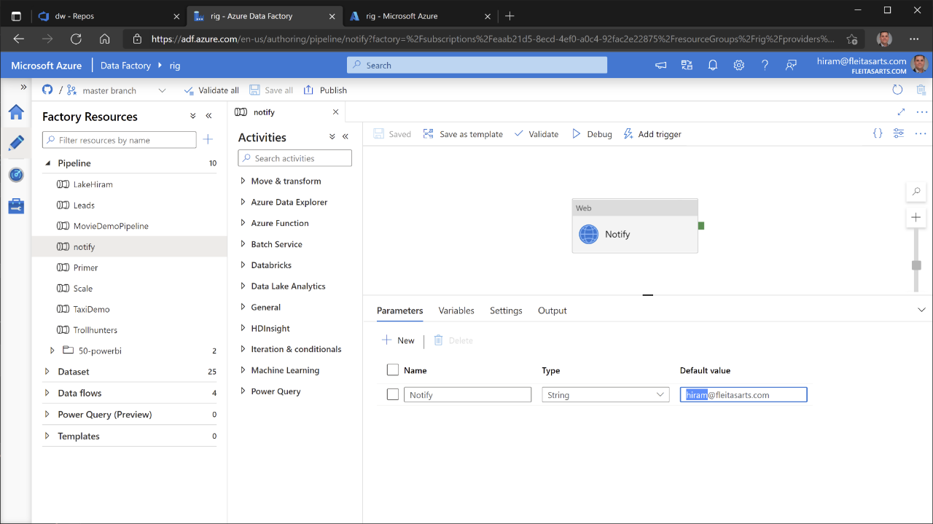


Slide 9
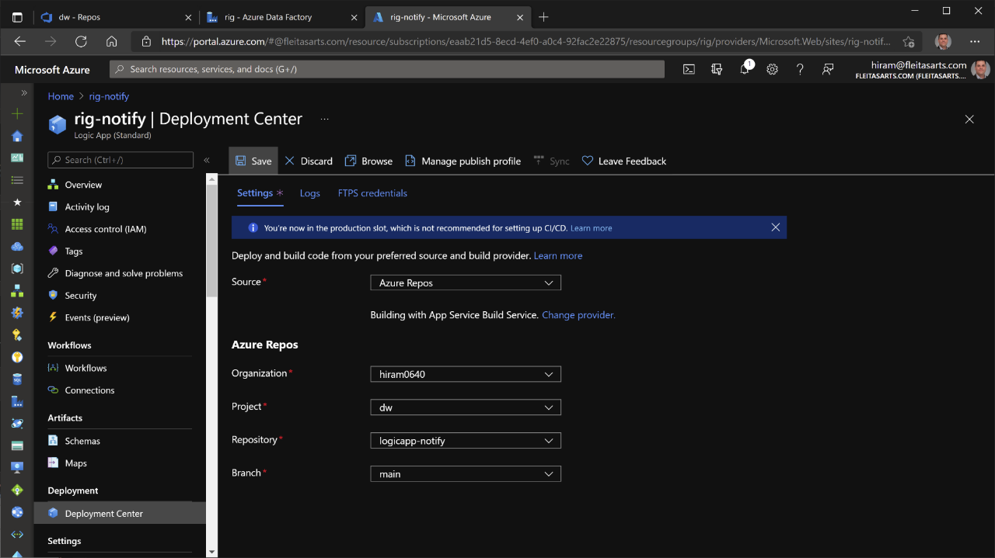


Slide 10
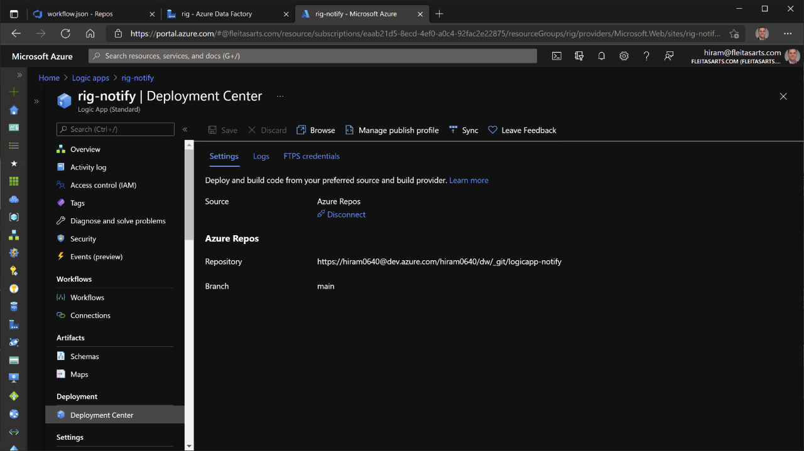

Slide 11
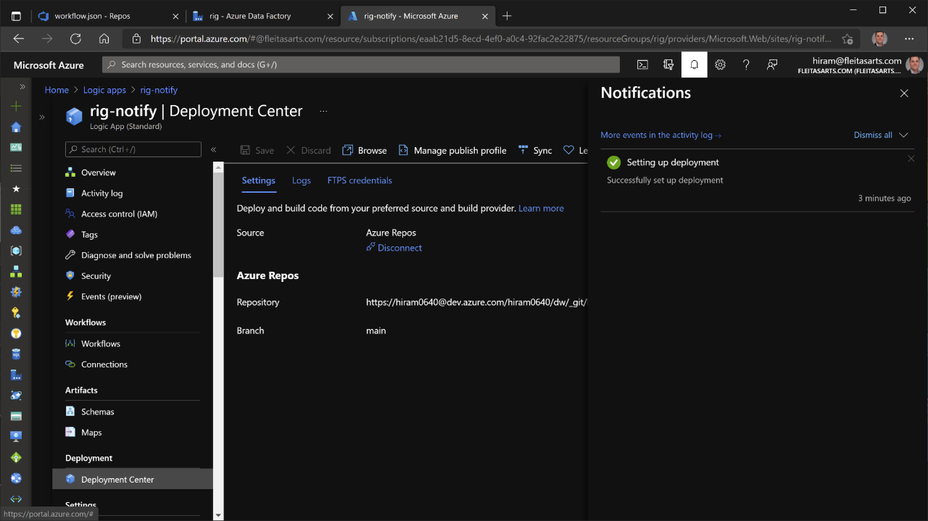

Slide 12
✅ Connected Logic App to repo

Slide 13
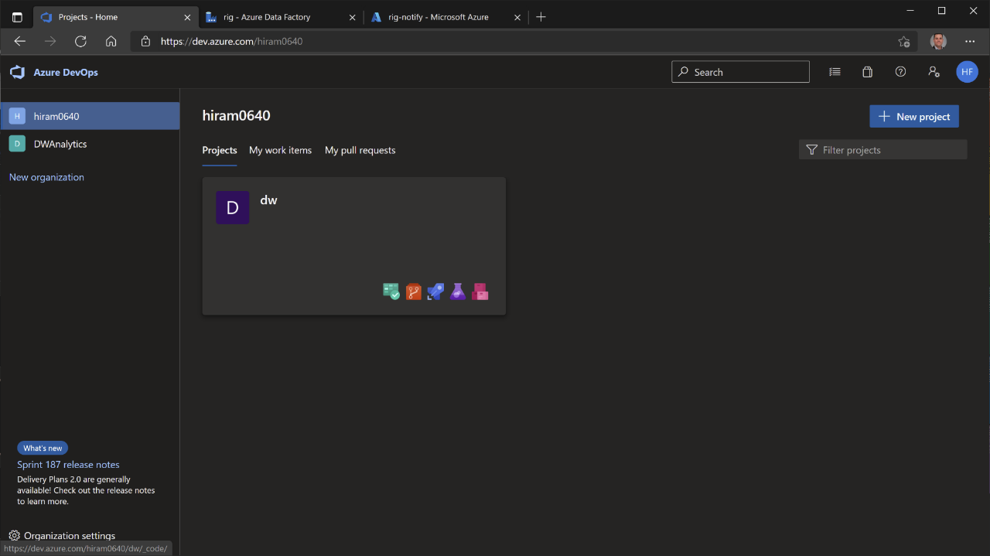

Slide 14
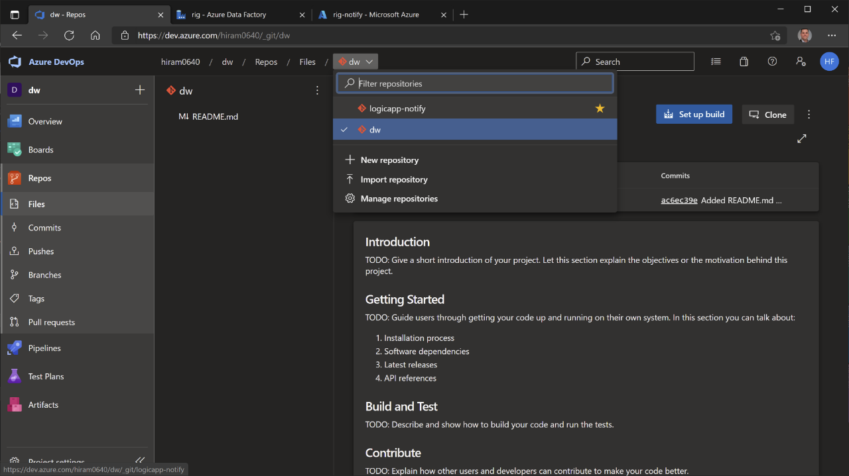

Slide 15
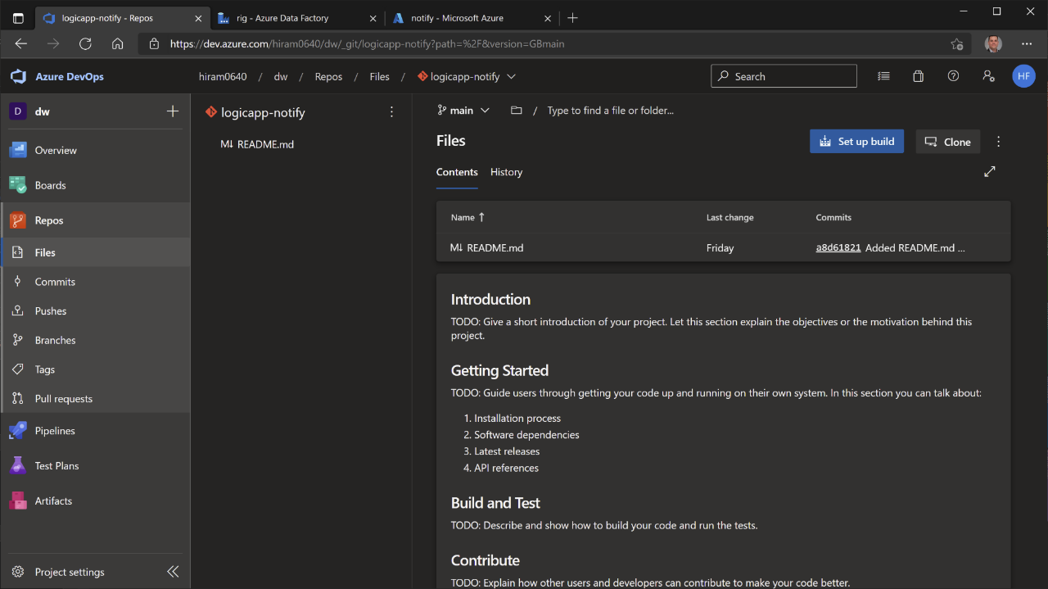

Slide 16
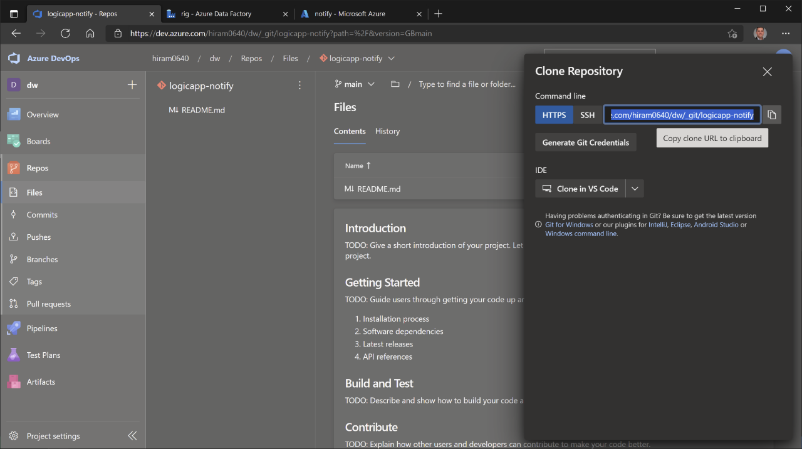

Slide 17
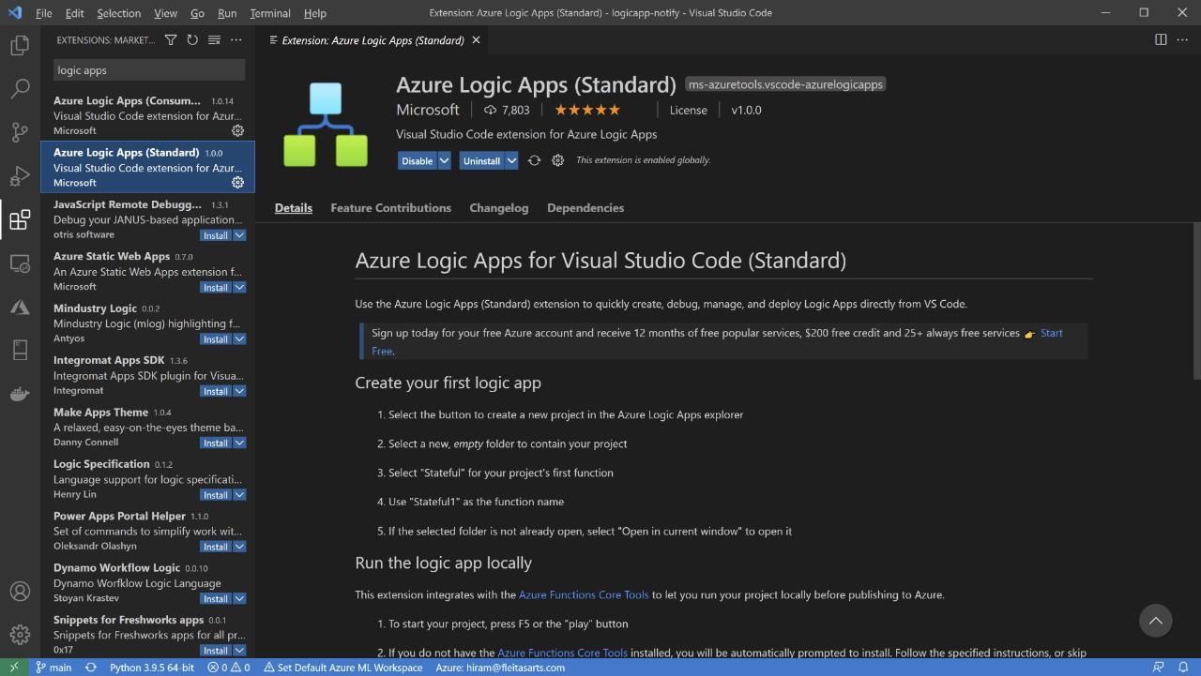

Slide 18
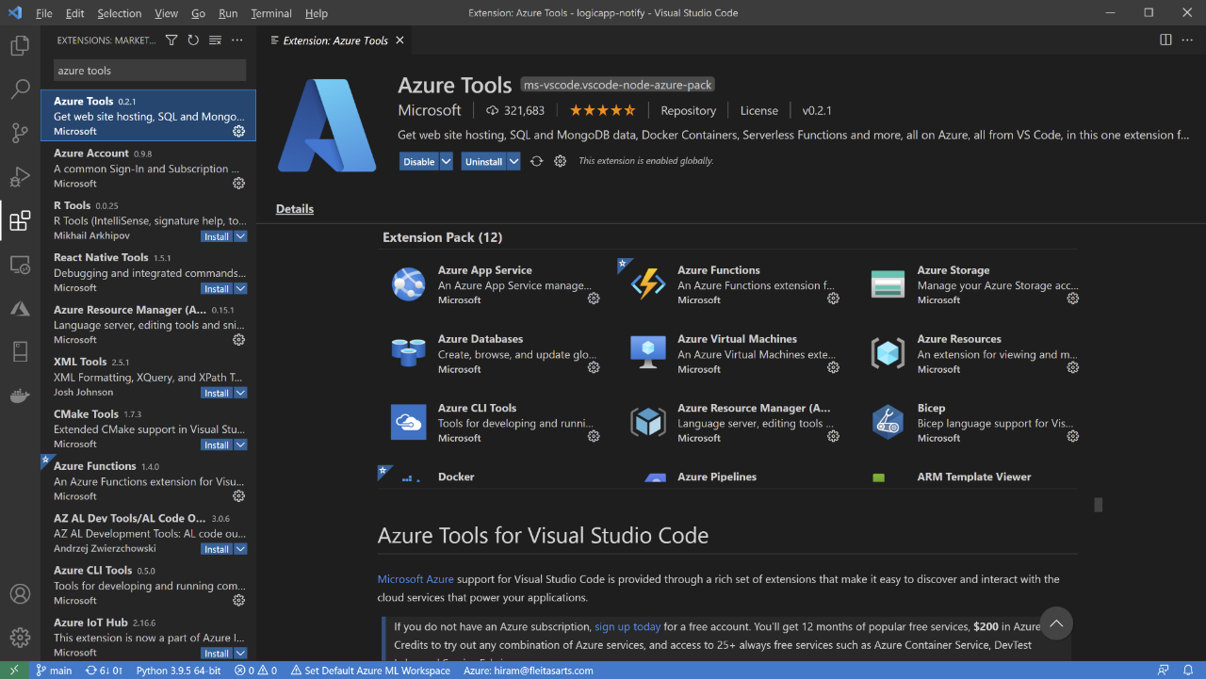

Slide 19
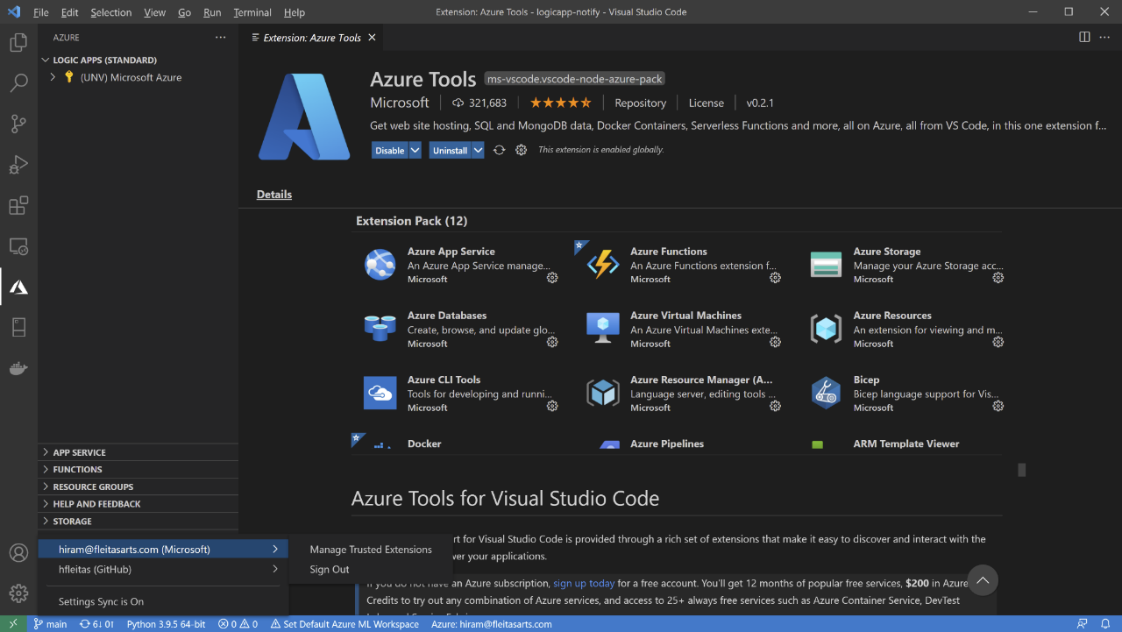

Slide 20
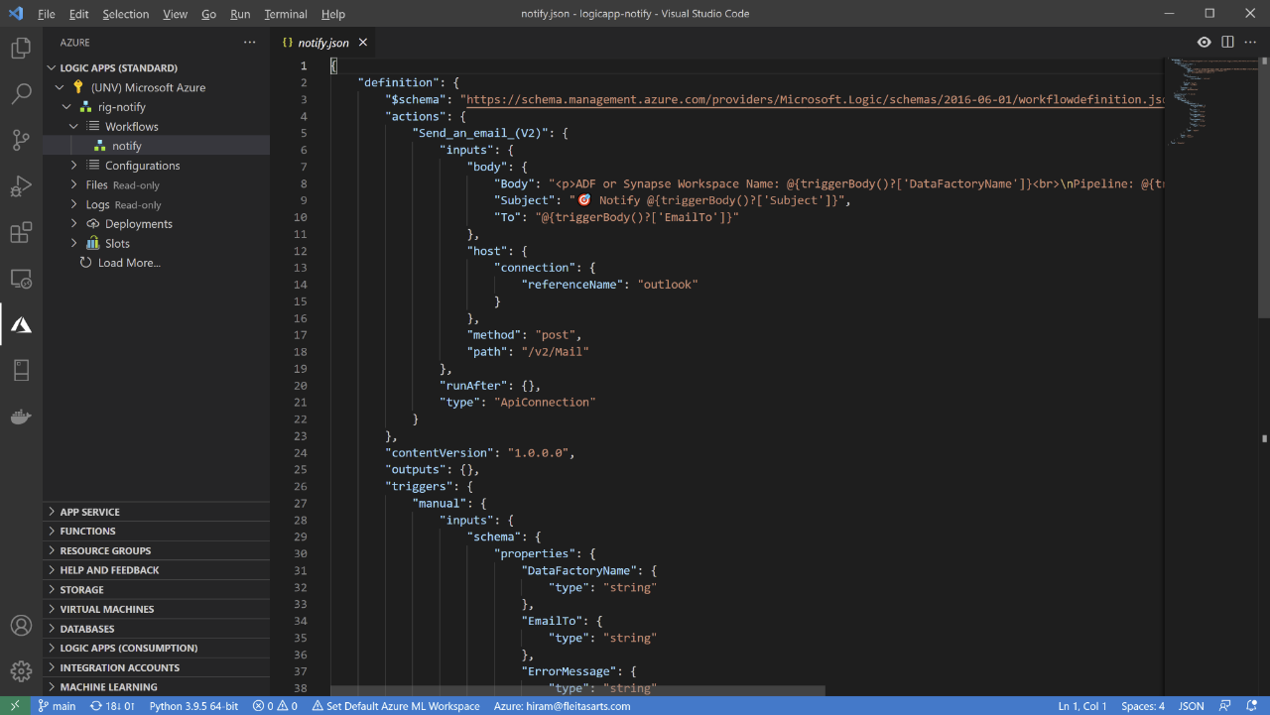

Slide 21
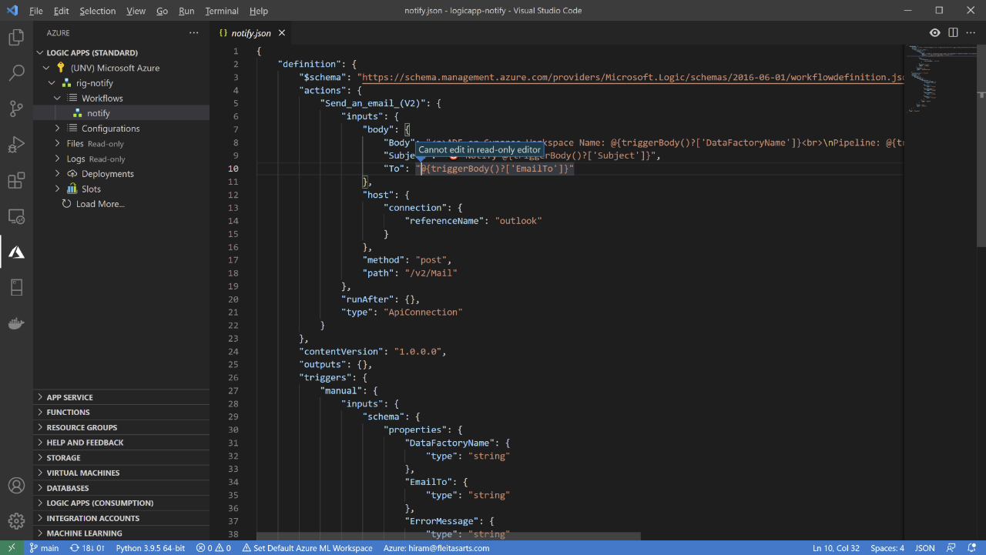

Slide 22
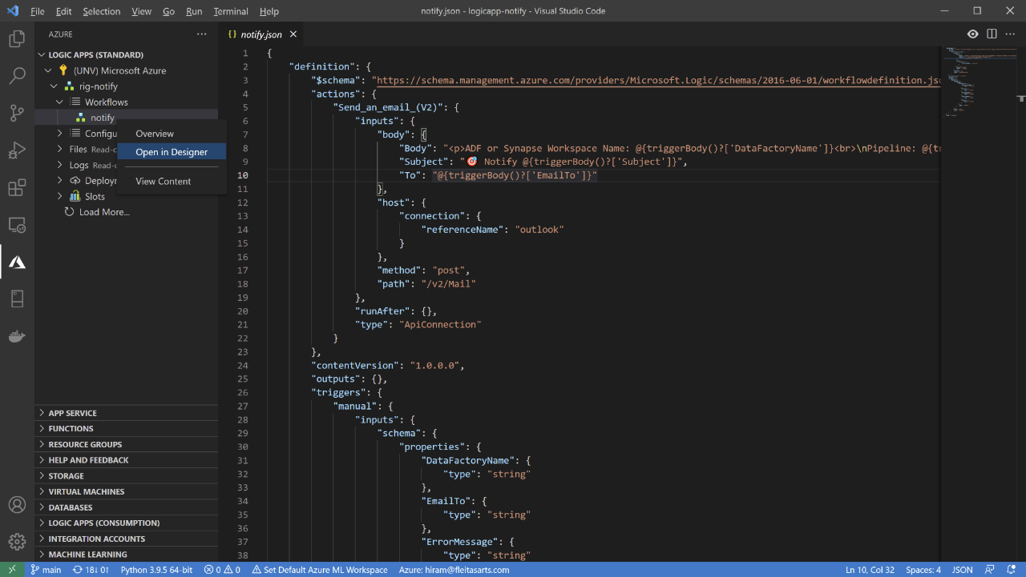

Slide 23
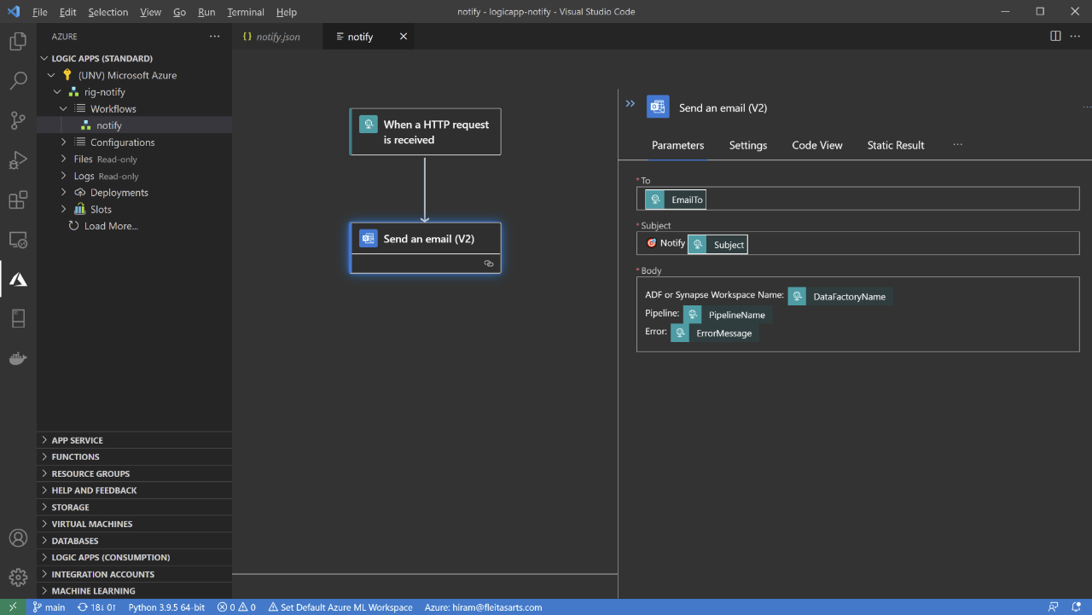

Slide 24
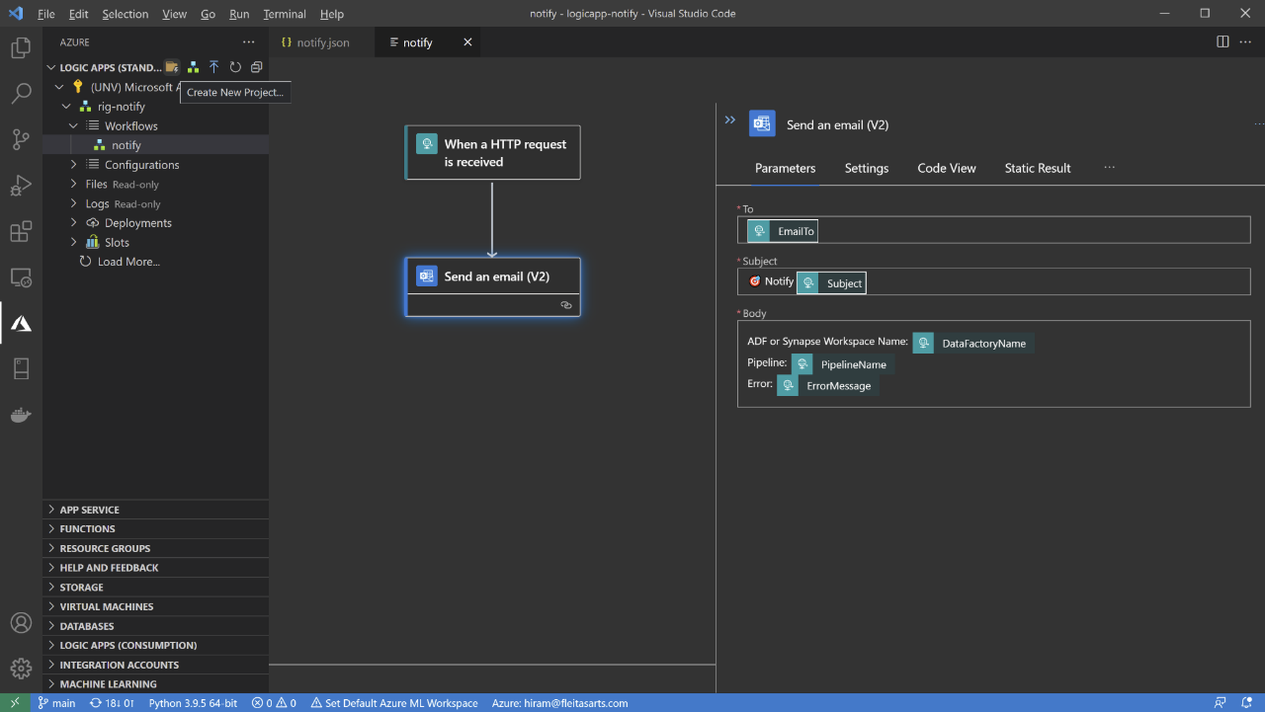

Slide 25
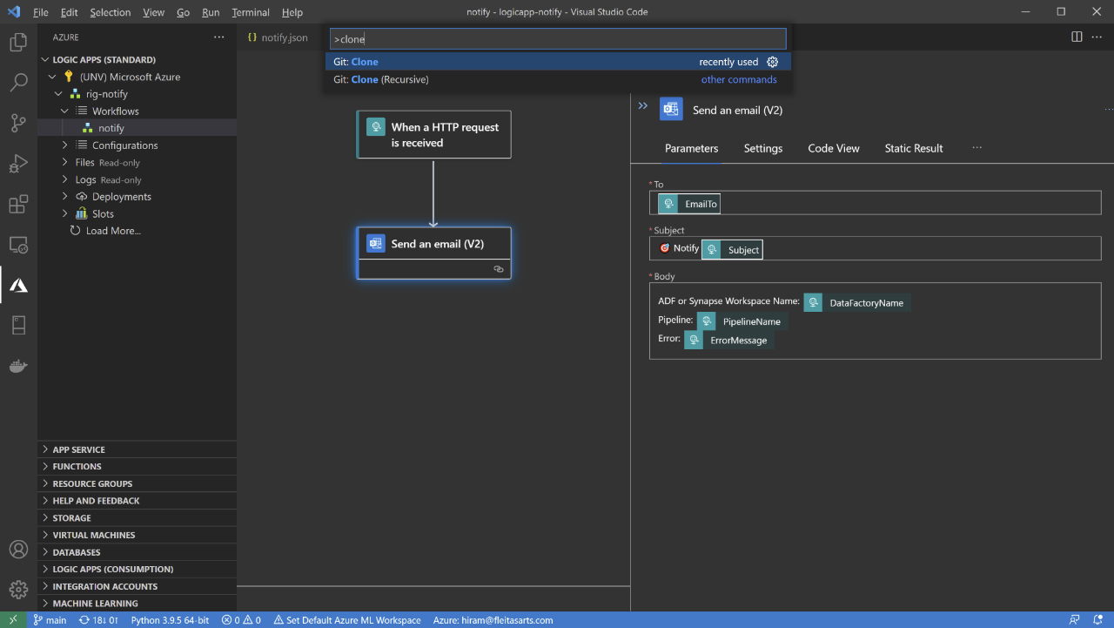
Ctrl + Shift + P
(Command Palette)

Slide 26
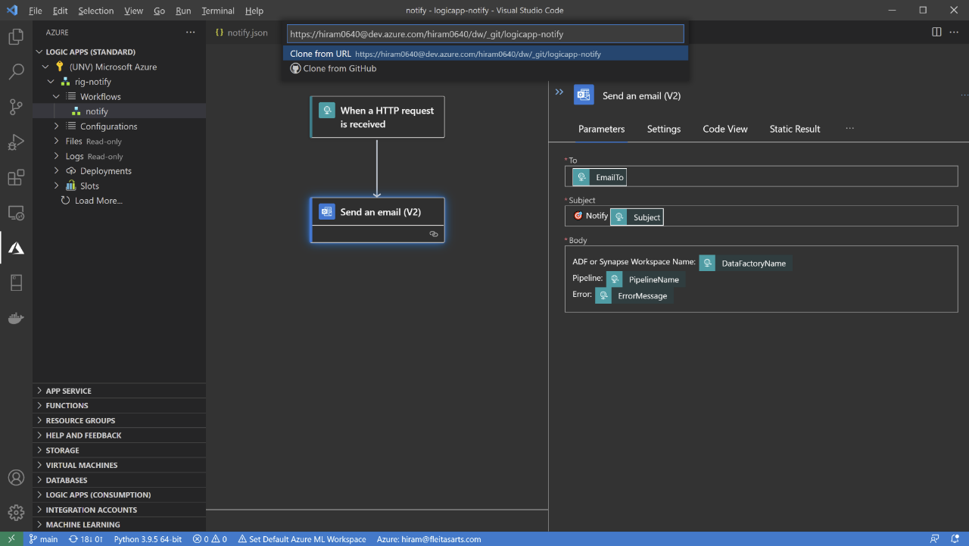

Slide 27
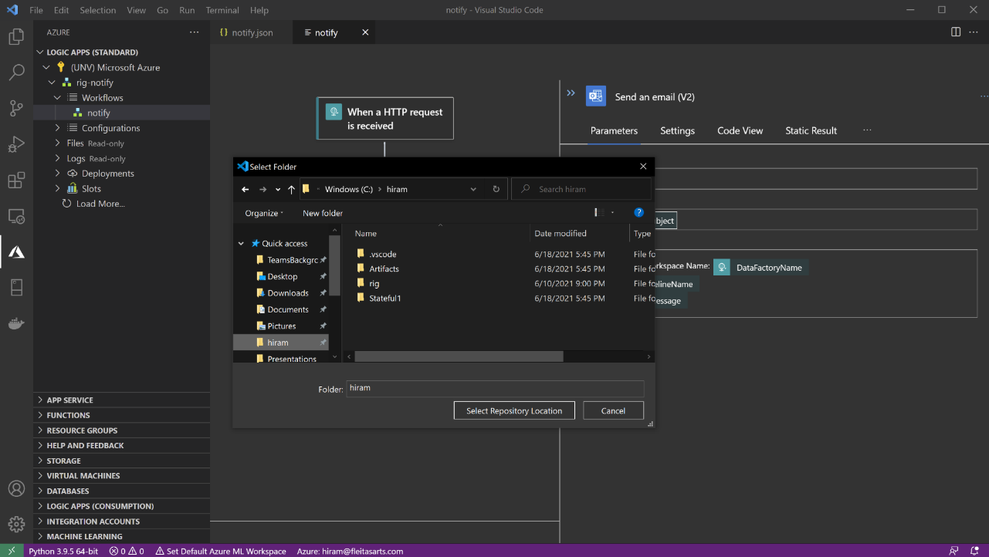

Slide 28
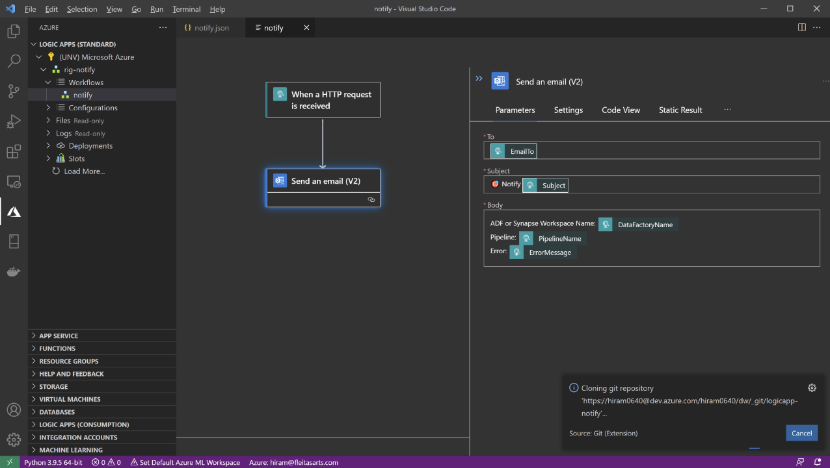

Slide 29
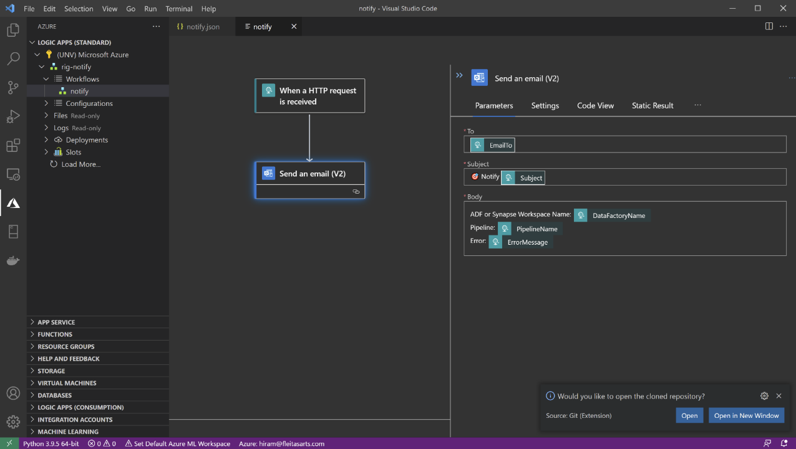

Slide 30
✅ Connected Logic App to repo
✅ Cloned repo
✅ Installed extensions

Slide 32
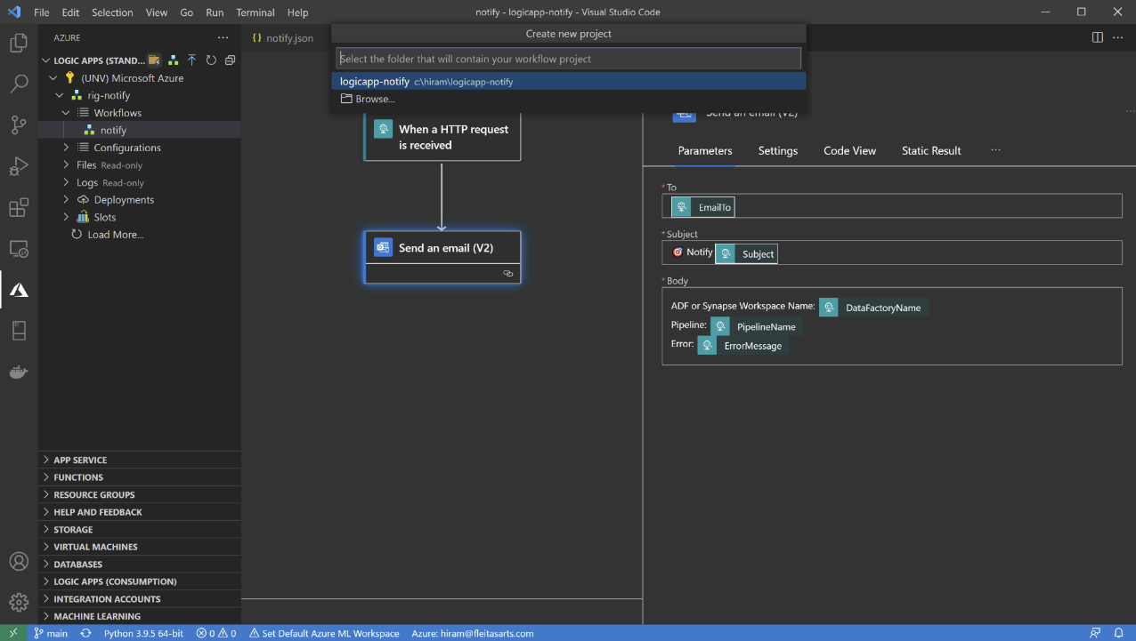

Slide 33
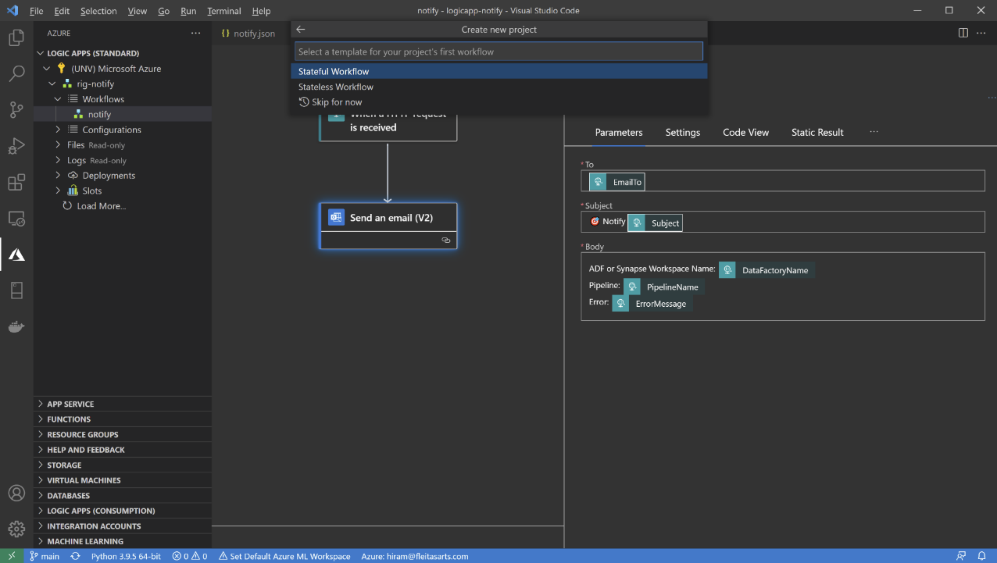

Slide 34
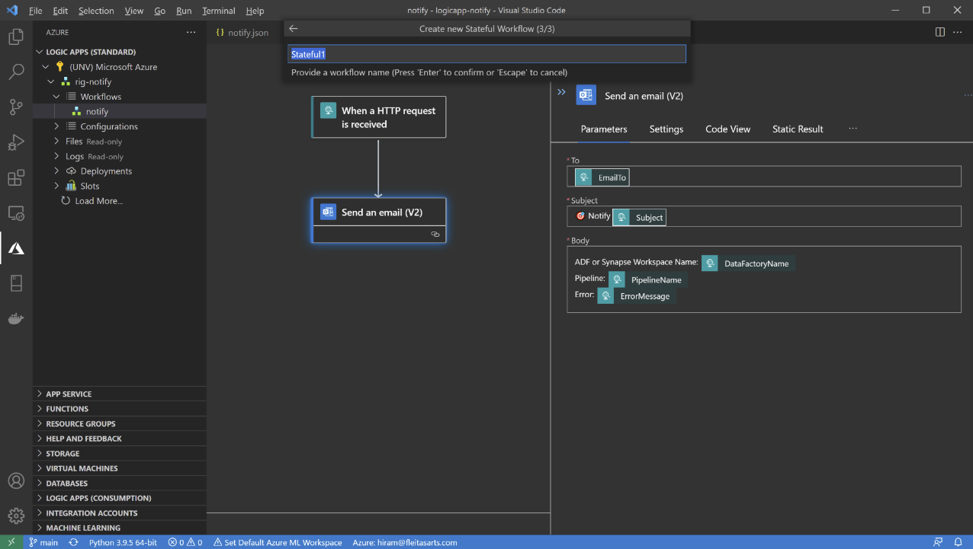

Slide 35
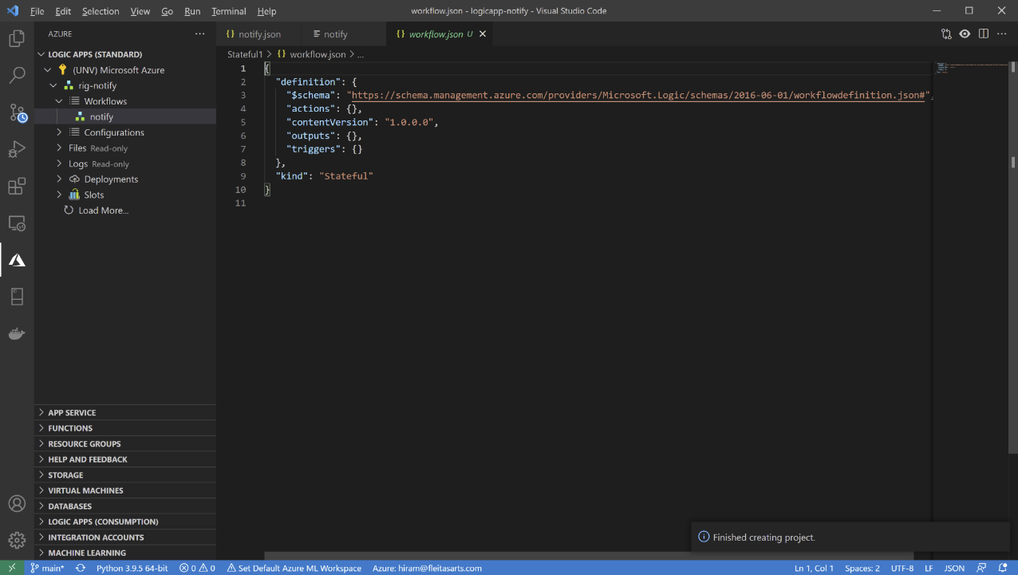

Slide 36
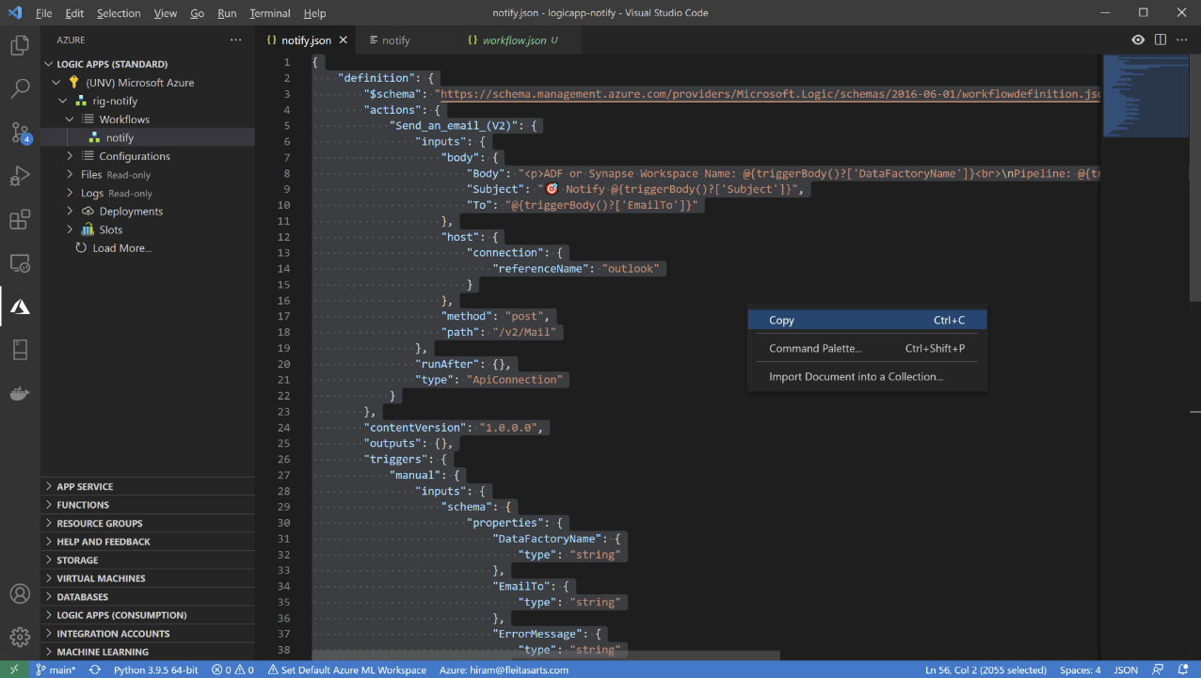

Slide 37
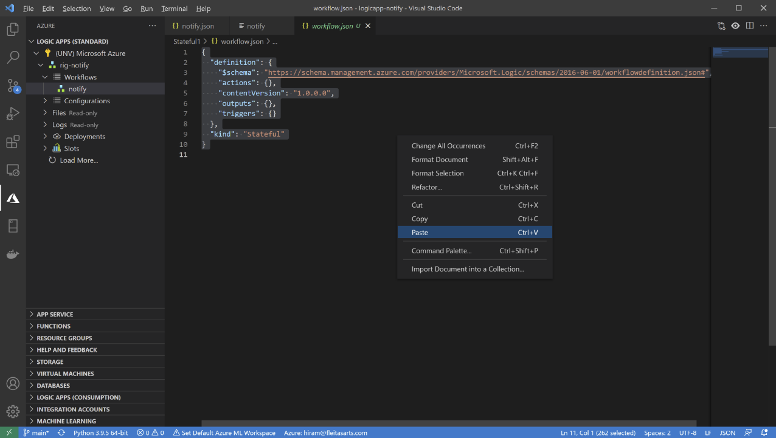

Slide 38
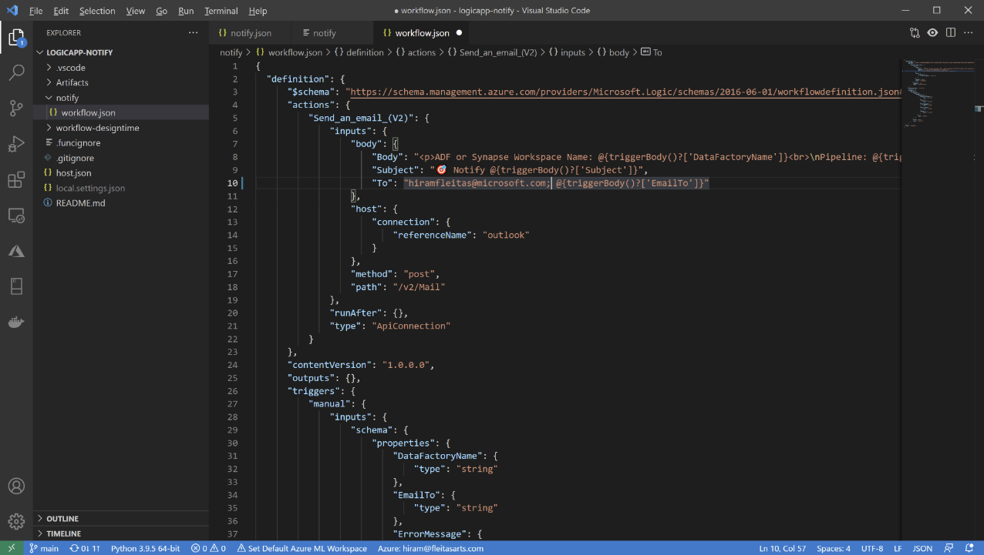
Ctrl + S
(Save)

Slide 39
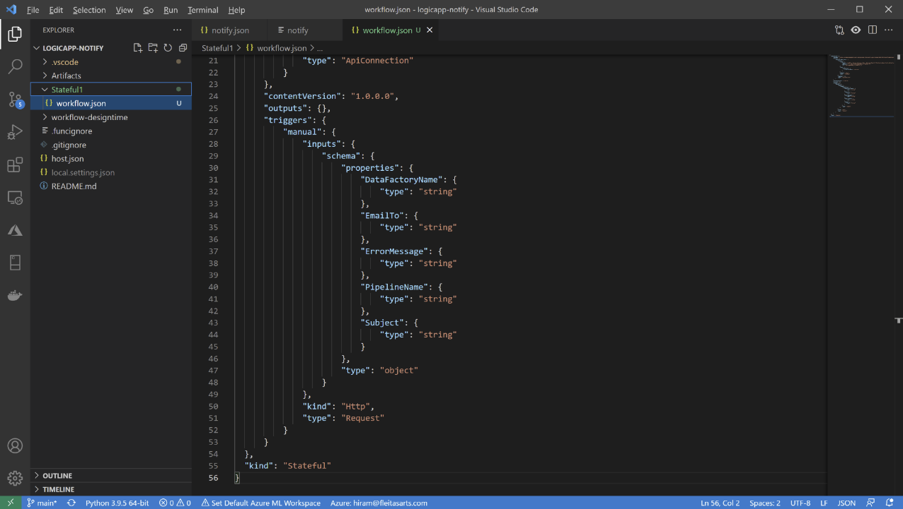

Slide 40
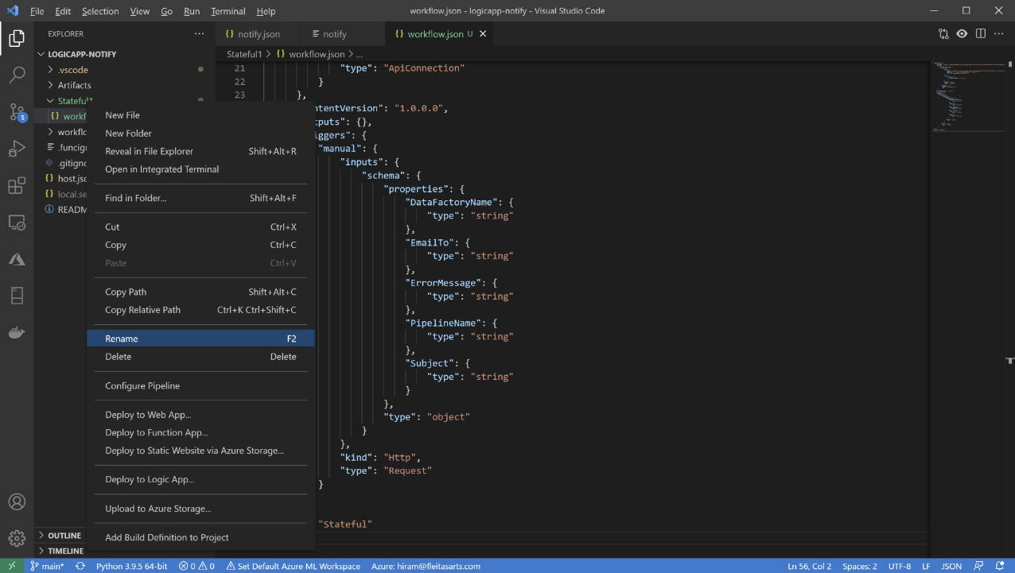

Slide 41
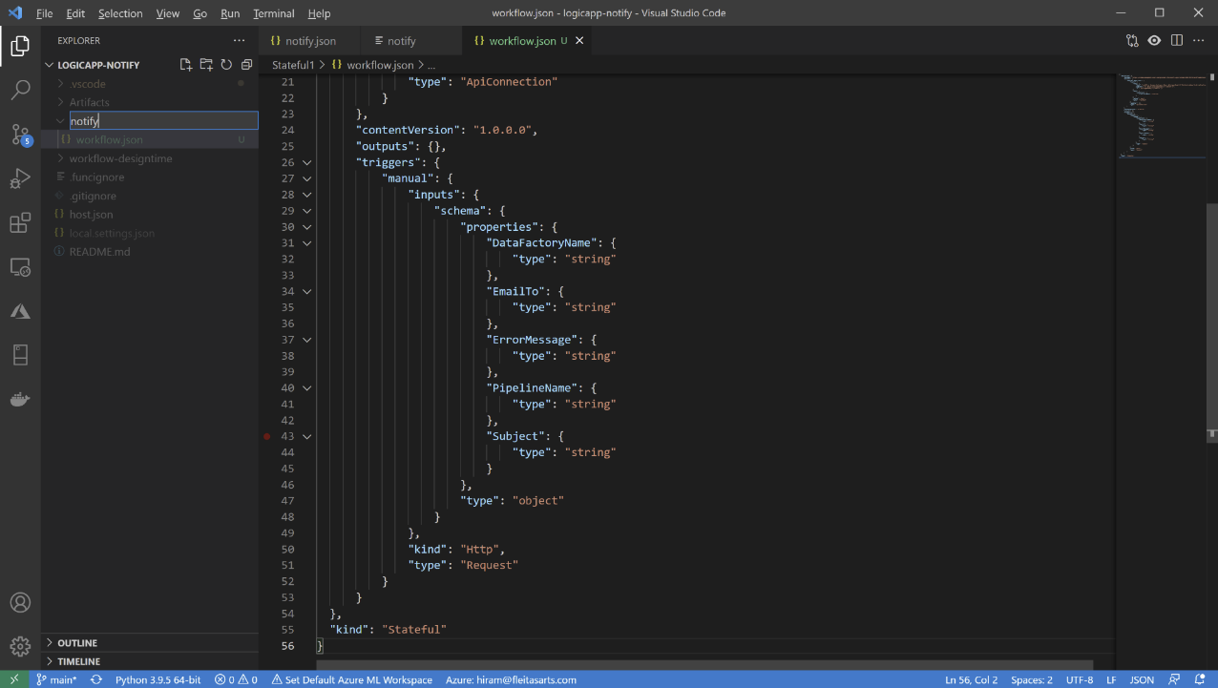

Slide 42
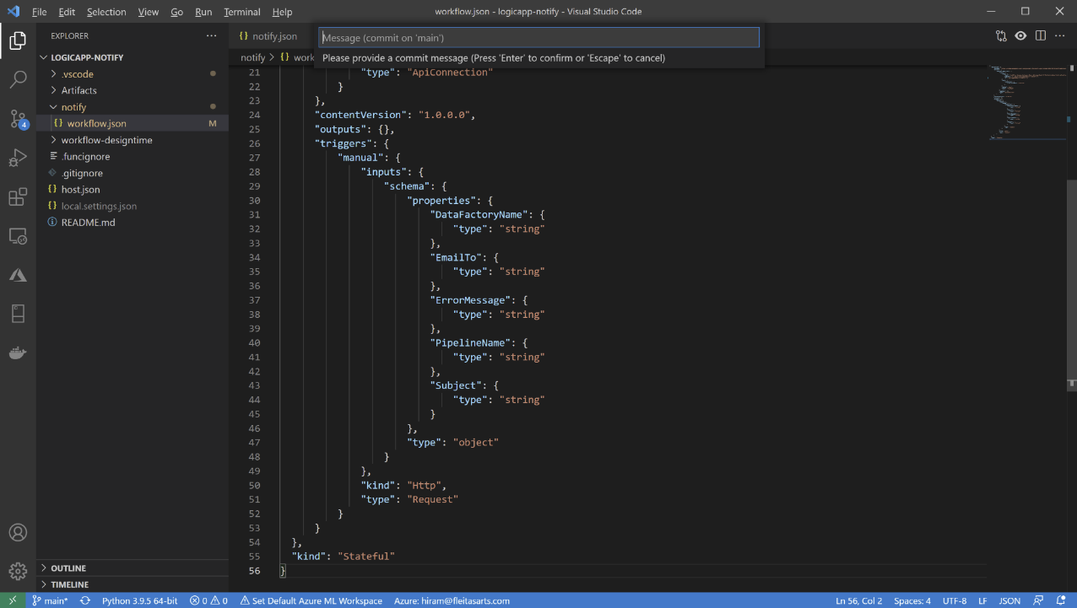
Ctrl + Alt + C
(Commit)

Slide 43
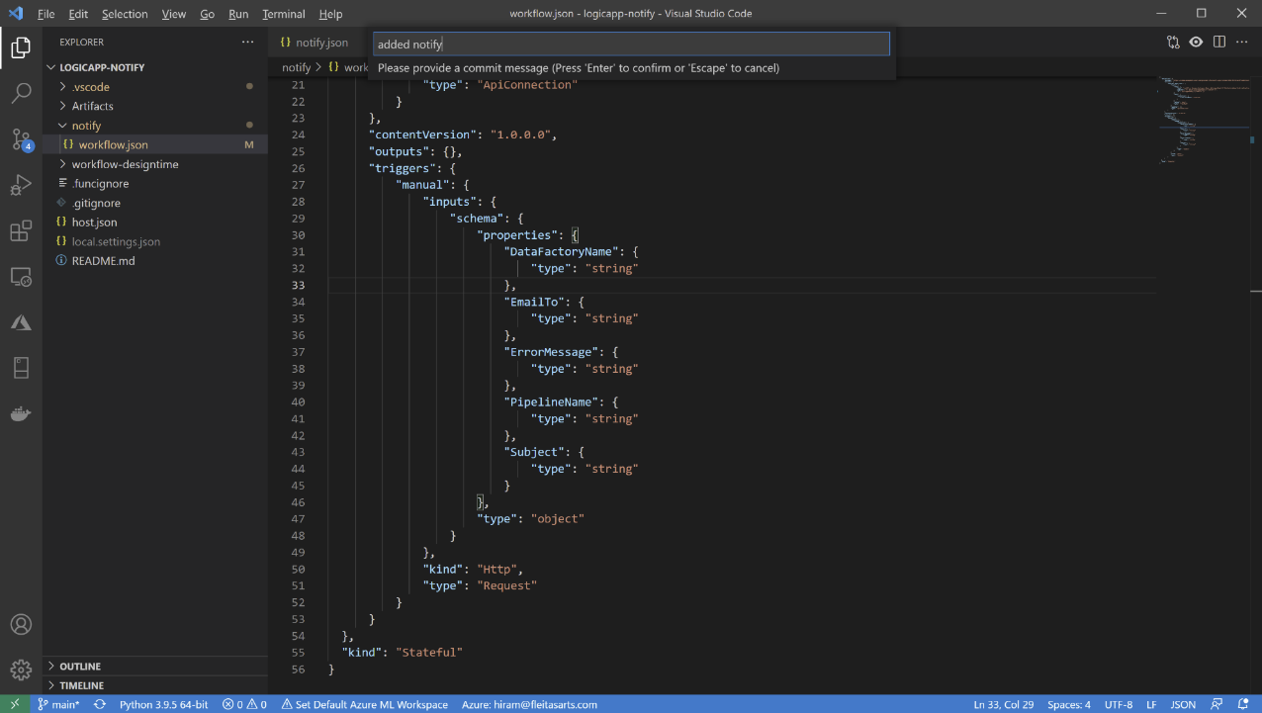

Slide 44
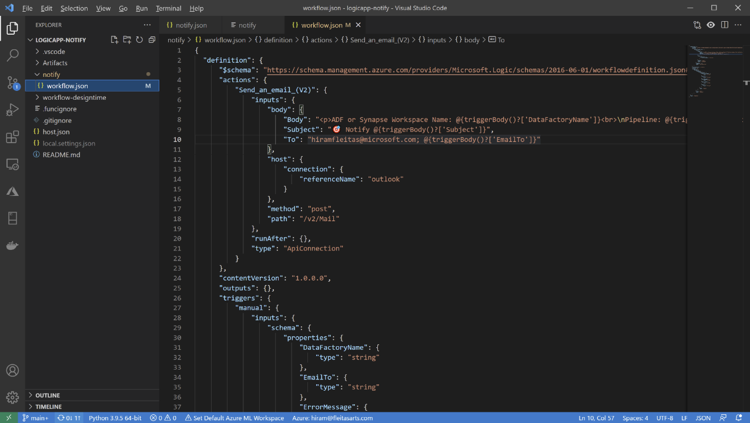

Slide 45
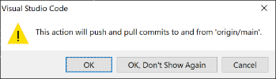

Slide 46
✅ Connected Logic App to repo
✅ Cloned repo
✅ Installed extensions
✅ Applied changes
✅ Committed & Synced

Slide 47
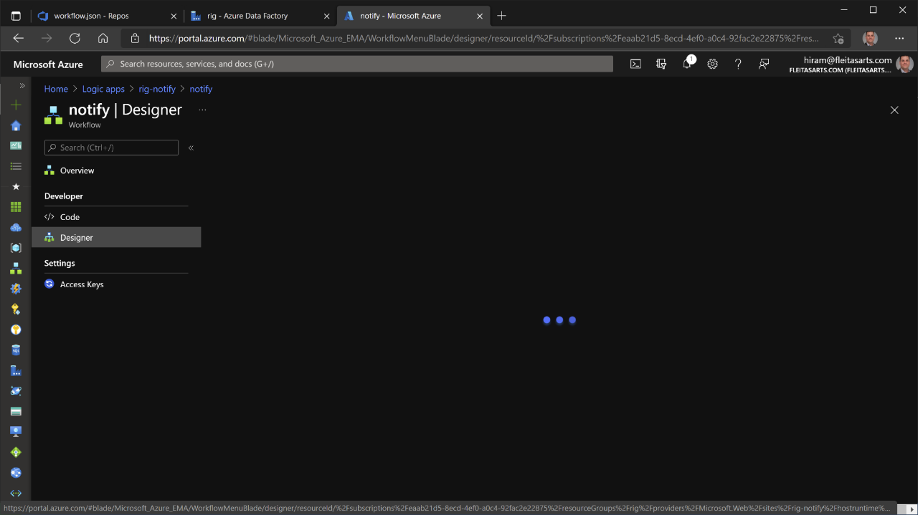

Slide 48
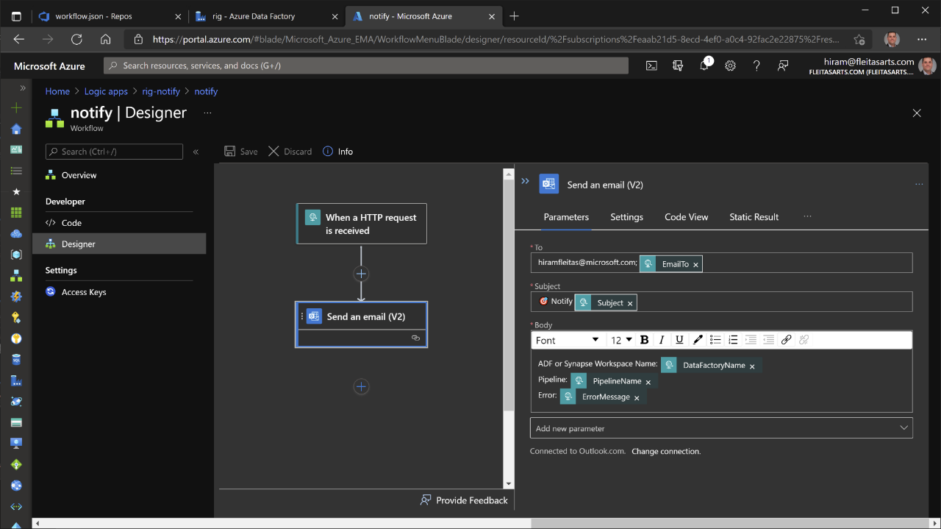


Slide 49
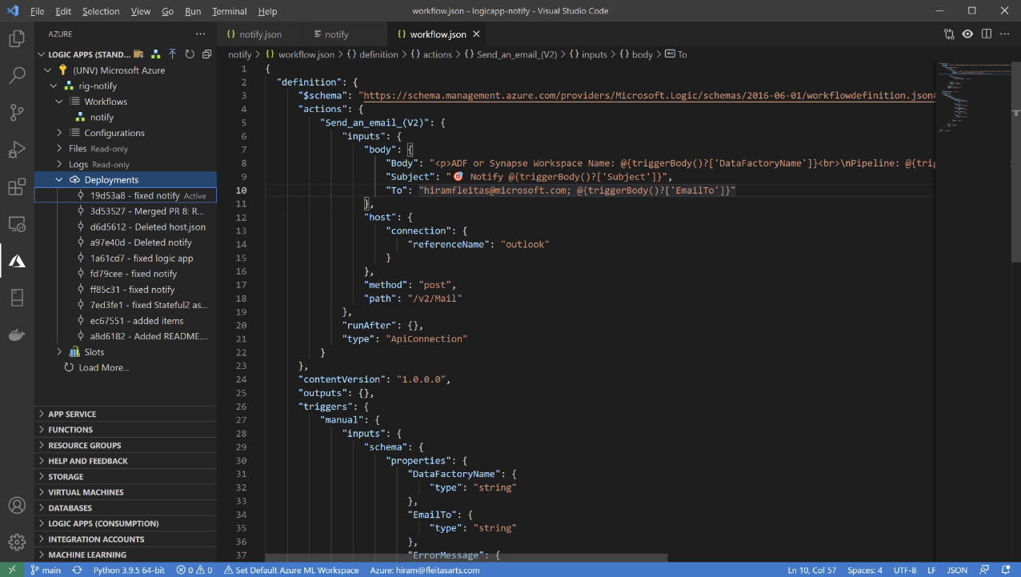

Slide 50
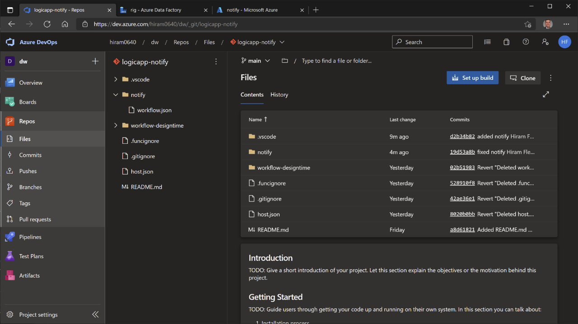

Slide 51
Summary
Connected Logic App to Azure DevOps
Commit changes in VS Code using Logic Apps extension
Deployment Center automatically facilitated CI/CD
Azure
Data Factory
Logic App
DevOps
VS Code

Slide 52
Resources
Azure Logic Apps – Build powerful integration solutions.
https://aka.ms/logicapps
Azure DevOps – Plan smatter, collaborate better, and ship faster.
https://aka.ms/devops
VS Code – Free. Built on open source. Runs everywhere.
https://aka.ms/vscode

Slide 53
Eval
Your feedback is appreciated.
bit.ly/hiram720eval

Slide 54
Thank you
Hiram Fleitas
https://aka.ms/hiram
https://bit.ly/hiram720

